Slide 1


<Abderrahim SEBBAR>
<09.10.2021>

Slide 2

Outline
Executive Summary
Introduction
Methodology
Results
Conclusion
Appendix

Slide 3
Executive Summary
We will determine if the first stage will land and we will determine the cost of a launch :
We use data analysis tools (RESTfulAPI,web scraping...) to load a dataset, clean it, and find out interesting insights from it.
Guide the modeling process by using data visualization skills (SQL,FOLIUM,Plotly Dash…) to visualize data and extract meaningful models.
As a result of all the above stages, we found that the success of the first stage of the landing was linked
the mass of the lower payload, the orbit of the launch concerned, the booster version...,
In addition, we analyzed several predictive models to facilitate machine learning and we found that while several models such as logistic regression, SVM and KNN provide a best precision .

Slide 4
Introduction
Project background and context :
A Space Y company wants to know the costs and information needed to bid against SpaceX for a rocket launch by studying data from a company Space X.
Problems you want to find answers :
Impact of dependants variables (payload mass,Site...) on the success of first stage landing.
Predict the success rate of any future launch’s first stage landing.

Slide 5


Slide 6
Methodology
Executive Summary
Data collection methodology:
Data was collected from APIspaceX and from Wikipedia by web scraping .
Perform data wrangling
Data was processed by replacing messing value with mean value
Perform exploratory data analysis (EDA) using visualization and SQL
U​se SQL commands to filter, sort, & summarize data to visualize the data and extract meaningful patterns to guide the modeling process.
Perform interactive visual analytics using Folium and Plotly Dash
To visualize and interpret data in real-time.
Perform predictive analysis using classification models
Split data into training data and test data to find the best Hyperparameter for SVM, Class Trees, and Logistic Regression

Slide 7
Data Collection
Describe how data sets were collected.
You need to present your data collection process use key phrases and flowcharts

Slide 8
Data Collection – SpaceX API
Present your data collection with SpaceX REST calls using key phrases and flowcharts
FirstRepo/jupyter-labs-spacex-data-collection-api.ipynb at master · abderrahim22/FirstRepo (github.com)
Get() request
Json file response
Normalize a Json File
Storing and processing data (Pandas dataframe)

Slide 9
Data Collection - Scraping
Present your web scraping process using key phrases and flowcharts
FirstRepo/jupyter-labs-webscraping.ipynb at master · abderrahim22/FirstRepo (github.com)
Use HTTPGET method to request the HTML page from wikipedia, as an HTTP response
Extract all column from the HTML table via BeautifulSoup object
Create a data frame by parsing the HTML tables

Slide 10
Data Wrangling
Check for missing values and replace them with correct value
Format data to improve its processing
Preparing dataset for analysis
FirstRepo/labs-jupyter-spacex-Data wrangling.ipynb at master · abderrahim22/FirstRepo (github.com)
Check for missingvalues in the dataset
And replace them
Format data
Prepare Dataset for analysis

Slide 11
EDA with Data Visualization
Summarize what charts were plotted and why you used those charts
Scatter plots : to observe relationships between variables with color coding
Bar chart : to show comparisons between categories of data
line chart : to visualize the trend of something over time.
FirstRepo/jupyter-labs-eda-dataviz.ipynb at master · abderrahim22/FirstRepo (github.com)

Slide 12
EDA with SQL
Using bullet point format, summarize the SQL queries you performed
select Unique launch_site from SPACEXTBL
select * from SPACEXTBL where launch_site like 'CCA%' limit 5
select sum(payload_mass__kg_)as Total from SPACEXTBL where customer like 'NASA (CRS)‘
select avg(payload_mass__kg_)as averge from SPACEXTBL where booster_version like 'F9 v1.1‘
select min(DATE) from SPACEXTBL where landing__outcome like 'Success (ground pad)‘
select booster_version from SPACEXTBL where landing__outcome like 'Success (drone ship)' and payload_mass__kg_ between 4000 and 6000
select DISTINCT mission_outcome, COUNT(mission_outcome)as Total from SPACEXTBL group by mission_outcome
select booster_version from SPACEXTBL where payload_mass__kg_ = (select max(payload_mass__kg_) from SPACEXTBL)
select booster_version from SPACEXTBL where payload_mass__kg_ = (select max(payload_mass__kg_) from SPACEXTBL)
select landing__outcome,count(landing__outcome) as Count ,RANK() OVER (order by count(landing__outcome) ) as ORDER from SPACEXTBL WHERE landing__outcome in ('Failure (drone ship)','Success (ground pad)') and Date between '2010-06-04' and '2017-03-20' group by landing__outcome
FirstRepo/jupyter-labs-eda-sql-coursera.ipynb at master · abderrahim22/FirstRepo (github.com)

Slide 13
Build an Interactive Map with Folium
Summarize what map objects such as markers, circles, lines, etc. you created and added to a folium map
Circle
Marker
MarkerCluster
PolyLine
Mouse Position
Explain why you added those objects
Circle to add a highlighted circle area of sitemap
Marker for plotting markers on a map
MarkerCluster simply a map containing many markers
PolyLine to connect two points in the map
Mouse Position to define the coordinate on the map
FirstRepo/lab_jupyter_launch_site_location_interactive.ipynb at master · abderrahim22/FirstRepo (github.com)

Slide 14
Build a Dashboard with Plotly Dash
Summarize what plots/graphs and interactions you have added to a dashboard
Dropdown box
Pie chart
Range Slider
Scatter Plot
Explain why you added those plots and interactions
Dropdown box : to select the Site specific or ALL Sites
Pie chart : to display view of success rate for site selected
Range Slider : to choose the payload mass range
Scatter Plot :to describe the relation between payload mass and launch site on the success rate of landing
FirstRepo/spacex_dash_app.py at master · abderrahim22/FirstRepo (github.com)

Slide 15
Predictive Analysis (Classification)
Summarize how you built, evaluated, improved, and found the best performing classification model
Preprocess the data via method StandardScaler()
Split dataset into training data and test data
Create models, fit them via training data, predict using test data.
Evaluate score of all models and choose model with highest accuracy
repeat for each model
FirstRepo/SpaceX_Machine Learning Prediction_Part_5.ipynb at master · abderrahim22/FirstRepo (github.com)
1-Built model 2-fit traindata 3-bestparam
4-predict testdata 5-Accuracy score
Preprocess
via StandardScaler()
Split
Traindata/testdata
The best model

Slide 16
Results
Exploratory data analysis results
Interactive analytics demo in screenshots
Predictive analysis results

Slide 17


Slide 18
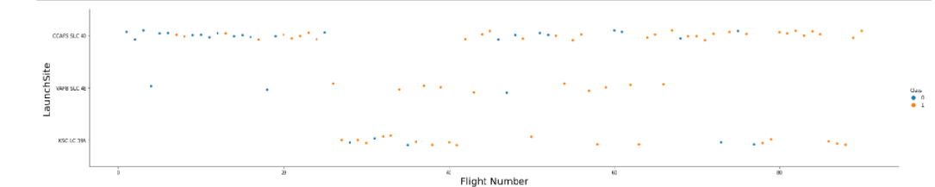
Flight Number vs. Launch Site
Show a scatter plot of Flight Number vs. Launch Site
CCAFS SLC 40 is used more as a launch site so it has a lower success rate, but the other two sites have a higher success rate and a lower number of flights.

Slide 19
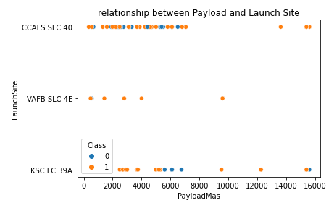
Payload vs. Launch Site
Show a scatter plot of Payload vs. Launch Site
The success rate appears to increase with a higher payload mass; With a mass less than 6000 kg, the KSC LC 39 A has a better success rate.

Slide 20
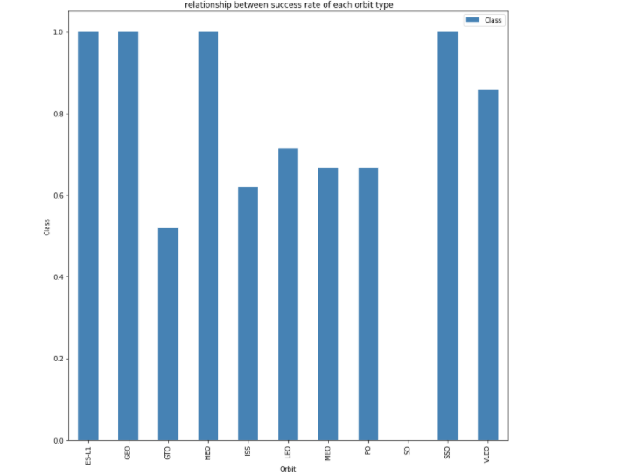
Success Rate vs. Orbit Type
Show a bar chart for the success rate of each orbit type
The Orbits ES-L1, GEO, HEO and SSO have Top average success rates
GTO orbit has lowest average success rate

Slide 21
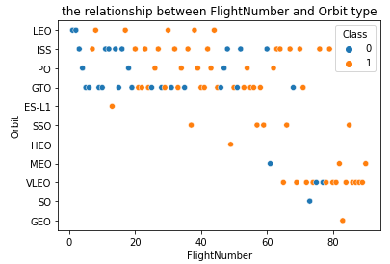
Flight Number vs. Orbit Type
Show a scatter point of Flight number vs. Orbit type
The orbits VLEO, SSO, MEO and GEO have a high success rates after 60 flight numbers
The orbits LEO, ISS, PO and GTO function better between 20 and 70 flight number

Slide 22
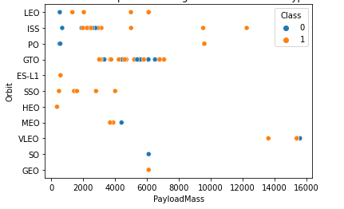
Payload vs. Orbit Type
Show a scatter point of payload vs. orbit type
The Heavy payloads have a negative influence on orbits .

Slide 23
Launch Success Yearly Trend
Show a line chart of yearly average success rate
The sucess rate since 2013 kept increasing till 2020

Slide 24
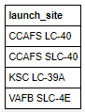
All Launch Site Names
Find the names of the unique launch sites
select Unique launch_site from SPACEXTBL
Present your query result with a short explanation here
we find the unique names of All launch sites from table spacextbl

Slide 25
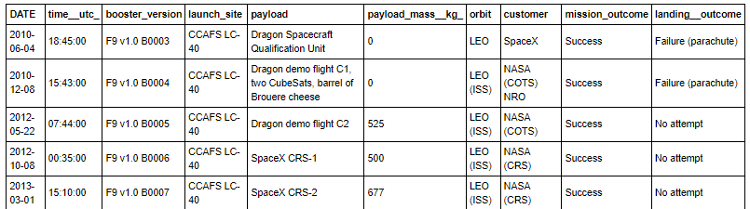
Launch Site Names Begin with 'CCA'
Find 5 records where launch sites begin with `CCA`
select * from SPACEXTBL where launch_site like 'CCA%' limit 5
Present your query result with a short explanation here
Display five records from table SPACEXTBL for only the launch sites begin with ‘CCA’

Slide 26
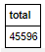
Total Payload Mass
Calculate the total payload carried by boosters from NASA
select sum(payload_mass__kg_)as Total from SPACEXTBL where customer like 'NASA (CRS)'
Present your query result with a short explanation
Display the total of payload mass from SPACEXTBL Table just for
NASA (CRS) Customer.

Slide 27
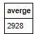
Average Payload Mass by F9 v1.1
Calculate the average payload mass carried by booster version F9 v1.1
select avg(payload_mass__kg_)as averge from SPACEXTBL where booster_version like 'F9 v1.1'
Present your query result with a short explanation
We calculate the averge payload Mass kg from SPACEXTBL Table for
Booster version F9v11

Slide 28
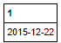
First Successful Ground Landing Date
Find the dates of the first successful landing outcome on ground pad
Present your query result with a short explanation
We use function min() to define the first successful landing
outcome on ground pad from SPACEXTBL Table

Slide 29
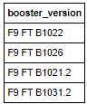
Successful Drone Ship Landing with Payload between 4000 and 6000
List the names of boosters which have successfully landed on drone ship and had payload mass greater than 4000 but less than 6000
Present your query result with a short explanation
We select the booster version from SPACEXTBL Table with
two conditions : 1. Successful Drone Ship Landing
2. Payload between 4000 and 6000

Slide 30
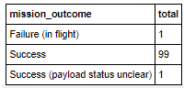
Total Number of Successful and Failure Mission Outcomes
Calculate the total number of successful and failure mission outcomes
Present your query result with a short explanation
We observe the number of successful mission outcomes
I is 99 and failure is 1 from SPACEXTBL Table

Slide 31
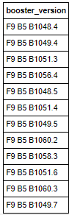
Boosters Carried Maximum Payload
List the names of the booster which have carried the maximum payload mass
Present your query result with a short explanation
We obtain list of the booster version from SPACEXTBL table with the Max Payload

Slide 32
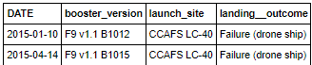
2015 Launch Records
List the failed landing_outcomes in drone ship, their booster versions, and launch site names for in year 2015
Present your query result with a short explanation
we have just two launch records in 2015

Slide 33
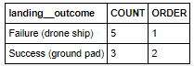
Rank Landing Outcomes Between 2010-06-04 and 2017-03-20
Rank the count of landing outcomes (such as Failure (drone ship) or Success (ground pad)) between the date 2010-06-04 and 2017-03-20, in descending order
Present your query result with a short explanation
We use rank function to order the count of landing outcomes between
Two dates.

Slide 34


Slide 35
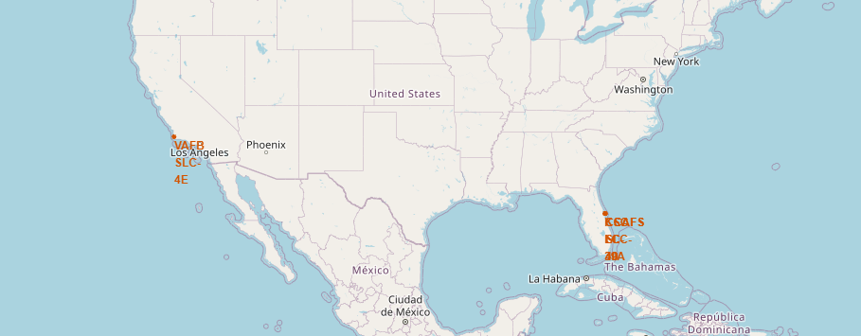
The map with all launch sites
The map with all launch sites
Explain the important elements and findings on the screenshot :
we can explore the map by zoom-in/out the marked areas , and try to observe all proximities(coast…)

Slide 36
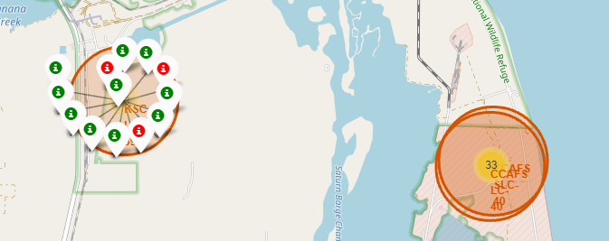
The success/failed launches for each site on the map
Mark the success/failed launches for each site on the map
From the color-labeled markers in marker clusters, we be able to easily identify which launch sites have relatively high success rates.

Slide 37
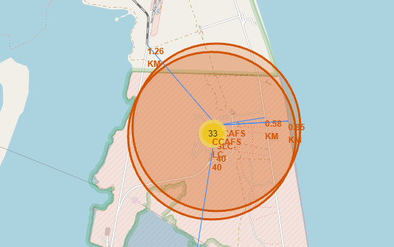
the distances between a launch site to its proximities
The important element is the possibility to determinate the proximities for each launch sites

Slide 38


Slide 39
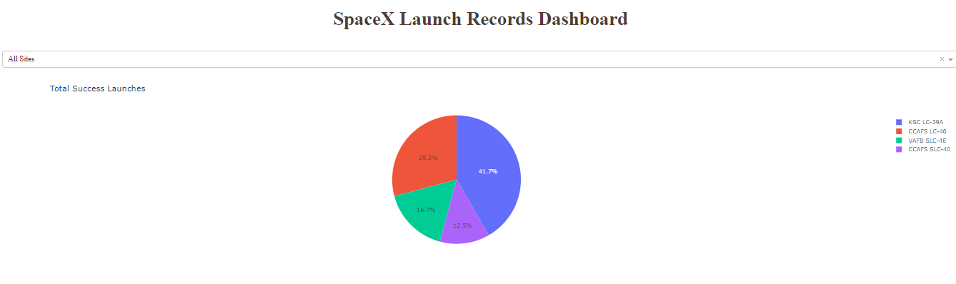
Launch success count for all sites
The important element is showing the total launch success for all launch sites and we can order all sites via pie char

Slide 40
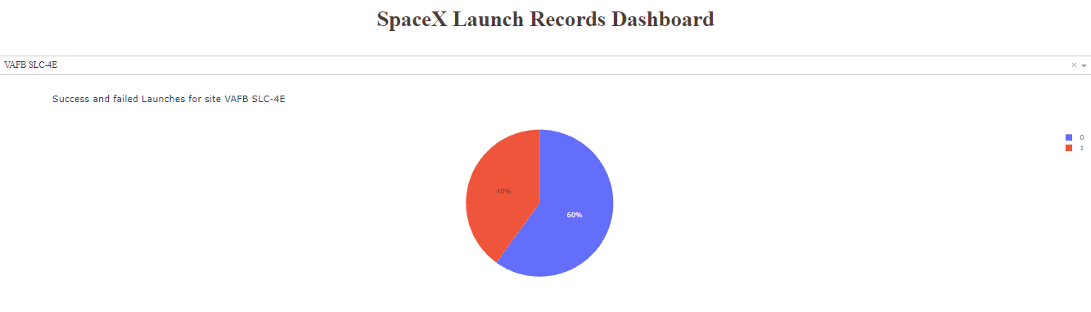
Success and Failed launch for a specific site
Explain the important element is the possibility to observe in real time by showing the Success and Failed launch for a specific Site.

Slide 41
Correlation between Payload and Success for all Sites
Show screenshots of Payload vs. Launch Outcome scatter plot for all sites, with different payload selected in the range slider
The booster version FT has the largest success rate.

Slide 42


Slide 43
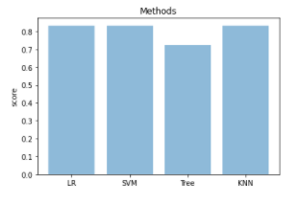
Classification Accuracy
Visualize the built model accuracy for all built classification models, in a bar chart
Find which model has the highest classification accuracy
Based on the Bar char We have three highest classification accuracy (LR,SVM,KNN) with score =0.83

Slide 44
Confusion Matrix
Show the confusion matrix of the best performing model with an explanation
The confusion matrix for the SVM ,KNN,LR models
predicts all 12 True positive answers for
successful landings.

Slide 45
Conclusion
We have achieved the objective presented at the beginning of this project, the company spaceY can see in the results the strategy used by the company SpaceX to make a successful investment in Space race.

Slide 46


